Slide 1
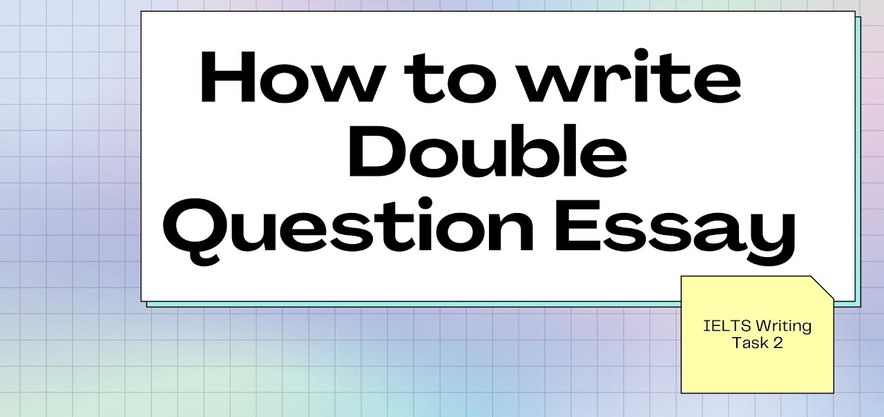

Slide 2
Double Question Essays
The Question
IELTS double question essays are also known as ‘direct question’ or ‘two questions’ essays. They are distinguished by two characteristics:
They have one statement with two different questions after it.
The questions may or may not be linked.

Slide 3
Double Question Essays
Nowadays the way people interact with each other has changed because of technology. In what ways has technology affected the types of relationships people make? Has this become a positive or negative development?
Give reasons for your answer and include any relevant examples from your own knowledge or experience.
Write at least 250 words.

Slide 4
Answer
Modern advancements have altered the way humans communicate with one another. People can now form bonds with other people all over the world, making strong connections, and that has resulted to a very welcoming development by uniting people worldwide.
For the first time in human history, people can communicate with someone they have never met before, in a country they have never been to, through the internet. These may not be the same kind of friendships we traditionally form face-to-face, but it is hard to dispute that they are not real relationships. Social media, such as Facebook and Instagram, provide a platform that allows us to chat and comment on someone else’s life instantaneously. For example, there are now multiple study groups on Facebook where students can help and support each other by providing helpful resources and feedback on different subjects and courses.
Overall, this new phenomenon has great benefits, principally encouraging tolerance of other cultures. Before computers, a person hardly ever came across someone from another culture, let alone people from a myriad of different places in one Facebook group. This has led to people understanding that regardless of their race and origin, everyone is same and one should not judge someone because they were born in a different place. For example, thousands of countries having past feuds have joined the same online groups that show support for peace and solidarity among themselves, something that would not have been possible even a decade ago.
In conclusion, the web has changed everyone’s interactions forever, making the world a global village where people can freely chat and form lasting connections and this essay concludes that this as a good thing that will continue to bring citizens of the world together.
(289 words)

Slide 5
BREAKDOWN AND EXPLANATION

Slide 6
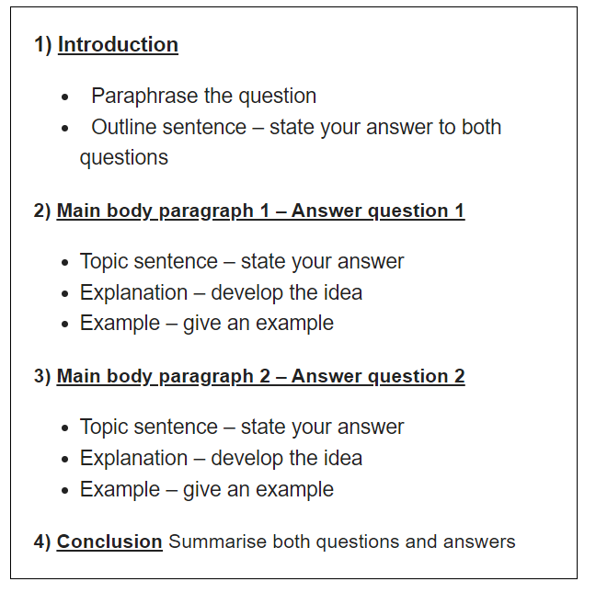
Double Question Essays

Slide 7
Introduction
A good introduction has a simple 3 part structure:
1) Paraphrased question
2) Outline sentence – state your answer to both questions
An introduction should:
Have 2-3 sentences
Be 40-60 words long
Take 5 minutes to write

Slide 8
Introduction
Question: Nowadays the way people interact with each other has changed because of technology. In what ways has technology affected the types of relationships people make? Has this become a positive or negative development?
Paraphrased question:
Modern advancements have altered the way humans communicate with one another.
Outline statement:
People can now form bonds with other people all over the world, making strong connections, and that has resulted to a very welcoming development by uniting people worldwide.
DO NOT GIVE ANY HEADING
THE HEADINGS OF THE PARAGRAPHS ARE FOR EXPLANATION ONLY
YOUR WRITING SHOULD ONLY HAVE PARAGRAPHS AS SHOWN IN THE LAST SLIDE

Slide 9
Introduction:
Modern advancements have altered the way humans communicate with one another. People can now form bonds with other people all over the world, making strong connections, and that has resulted to a very welcoming development by uniting people worldwide.
DO NOT GIVE ANY HEADING
THE HEADINGS OF THE PARAGRAPHS ARE FOR EXPLANATION ONLY
YOUR WRITING SHOULD ONLY HAVE PARAGRAPHS AS SHOWN IN THE LAST SLIDE

Slide 10
How To Write Main Body Paragraphs
Topic sentence
Explanation
Example

Slide 11
Main Body Paragraph 1: Worldwide Communication
Topic sentence:
For the first time in human history, people can communicate with someone they have never met before, in a country they have never been to, through the internet.
Explanation sentence:
These may not be the same kind of friendships we traditionally form face-to-face, but it is hard to dispute that they are not real relationships. Social media, such as Facebook and Instagram, provide a platform that allows us to chat and comment on someone else’s life instantaneously.
Example sentence:
For example, there are now multiple study groups on Facebook where students can help and support each other by providing helpful resources and feedback on different subjects and courses.
DO NOT GIVE ANY HEADING
THE HEADINGS OF THE PARAGRAPHS ARE FOR EXPLANATION ONLY
YOUR WRITING SHOULD ONLY HAVE PARAGRAPHS AS SHOWN IN THE LAST SLIDE

Slide 12
Finished Paragraph 1
For the first time in human history, people can communicate with someone they have never met before, in a country they have never been to, through the internet. These may not be the same kind of friendships we traditionally form face-to-face, but it is hard to dispute that they are not real relationships. Social media, such as Facebook and Instagram, provide a platform that allows us to chat and comment on someone else’s life instantaneously. For example, there are now multiple study groups on Facebook where students can help and support each other by providing helpful resources and feedback on different subjects and courses.
DO NOT GIVE ANY HEADING
THE HEADINGS OF THE PARAGRAPHS ARE FOR EXPLANATION ONLY
YOUR WRITING SHOULD ONLY HAVE PARAGRAPHS AS SHOWN IN THE LAST SLIDE

Slide 13
Main Body Paragraph 2: Unity-because of acceptance of others
Topic sentence:
Overall, this new phenomenon has great benefits, principally encouraging tolerance of other cultures.
Explanation sentence:
Before computers, a person hardly ever came across someone from another culture, let alone people from a myriad of different places in one Facebook group. This has led to people understanding that regardless of their race and origin, everyone is same and one should not judge someone because they were born in a different place.
Example sentence:
For example, thousands of countries having past feuds have joined the same online groups that show support for peace and solidarity among themselves, something that would not have been possible even a decade ago.
*myriad-a large quantity of things
DO NOT GIVE ANY HEADING
THE HEADINGS OF THE PARAGRAPHS ARE FOR EXPLANATION ONLY
YOUR WRITING SHOULD ONLY HAVE PARAGRAPHS AS SHOWN IN THE LAST SLIDE

Slide 14
Finished Paragraph 2
Overall, this new phenomenon has great benefits, principally encouraging tolerance of other cultures. Before computers, a person hardly ever came across someone from another culture, let alone people from a myriad of different places in one Facebook group. This has led to people understanding that regardless of their race and origin, everyone is same and one should not judge someone because they were born in a different place. For example, thousands of countries having past feuds have joined the same online groups that show support for peace and solidarity among themselves, something that would not have been possible even a decade ago.
DO NOT GIVE ANY HEADING
THE HEADINGS OF THE PARAGRAPHS ARE FOR EXPLANATION ONLY
YOUR WRITING SHOULD ONLY HAVE PARAGRAPHS AS SHOWN IN THE LAST SLIDE

Slide 15
Conclusion
You can start almost any final paragraph of an IELTS essay with the words:
In conclusion
or
To conclude
To create a great conclusion, you simply have to paraphrase the introduction

Slide 16
Question: Nowadays the way people interact with each other has changed because of technology. In what ways has technology affected the types of relationships people make? Has this become a positive or negative development?
Introduction:
Modern advancements have altered the way humans communicate with one another. People can now form bonds with other people all over the world, making strong connections, and that has resulted to a very welcoming development by uniting people worldwide.
Conclusion
In conclusion, the web has changed everyone’s interactions forever, making the world a global village where people can freely chat and form lasting connections and this essay concludes that this as a good thing that will continue to bring citizens of the world together.
DO NOT GIVE ANY HEADING
THE HEADINGS OF THE PARAGRAPHS ARE FOR EXPLANATION ONLY
YOUR WRITING SHOULD ONLY HAVE PARAGRAPHS AS SHOWN IN THE LAST SLIDE

Slide 17
Answer
Modern advancements have altered the way humans communicate with one another. People can now form bonds with other people all over the world, making strong connections, and that has resulted to a very welcoming development by uniting people worldwide.
For the first time in human history, people can communicate with someone they have never met before, in a country they have never been to, through the internet. These may not be the same kind of friendships we traditionally form face-to-face, but it is hard to dispute that they are not real relationships. Social media, such as Facebook and Instagram, provide a platform that allows us to chat and comment on someone else’s life instantaneously. For example, there are now multiple study groups on Facebook where students can help and support each other by providing helpful resources and feedback on different subjects and courses.
Overall, this new phenomenon has great benefits, principally encouraging tolerance of other cultures. Before computers, a person hardly ever came across someone from another culture, let alone people from a myriad of different places in one Facebook group. This has led to people understanding that regardless of their race and origin, everyone is same and one should not judge someone because they were born in a different place. For example, thousands of countries having past feuds have joined the same online groups that show support for peace and solidarity among themselves, something that would not have been possible even a decade ago.
In conclusion, the web has changed everyone’s interactions forever, making the world a global village where people can freely chat and form lasting connections and this essay concludes that this as a good thing that will continue to bring citizens of the world together.
(289 words)

